Slide 1

COVID19 vs NASDAQ
Were US Covid19 daily case numbers a predictor for the NASDAQ stock market index in 2020?

Slide 2
Data Analyzed
US Covid19 Daily Case Numbers provided by the European Centre Disease Control (ECDC)
NASDAQ Stock Index Daily Price provided by yahoo finance
The following period was analyzed: from 2019-07-01 to 2020-06-30

Slide 3
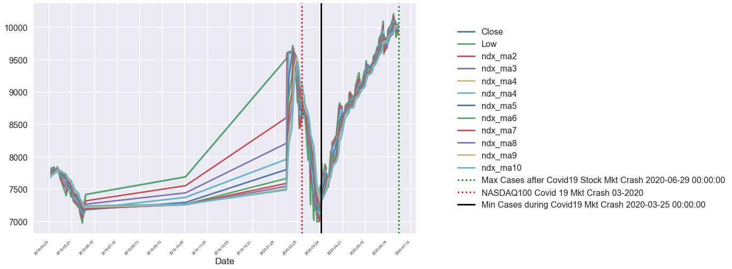
Data Visualisation NASDAQ

Slide 4
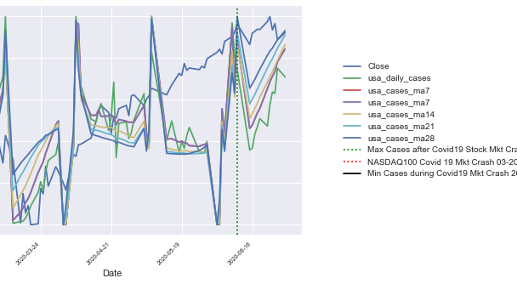
Data Visualisation NASDAQ vs COVID19

Slide 5

Results
There were no trends or radical shifts, except for the initial stock market crash on the first spike of US Covid19 Case Numbers reported in end of March 2020
There were no radical shifts in speed of trade time on the NASDAQ Daily Closing Price
The NASDAQ Daily Closing Price was more predictable 6 months DURING the Covid19 period then the periods
6 Months BEFORE
FIRST MONTH of spike in Covid19 Case numbers reported
6 Months BEFORE and 6 Months AFTER

Slide 6
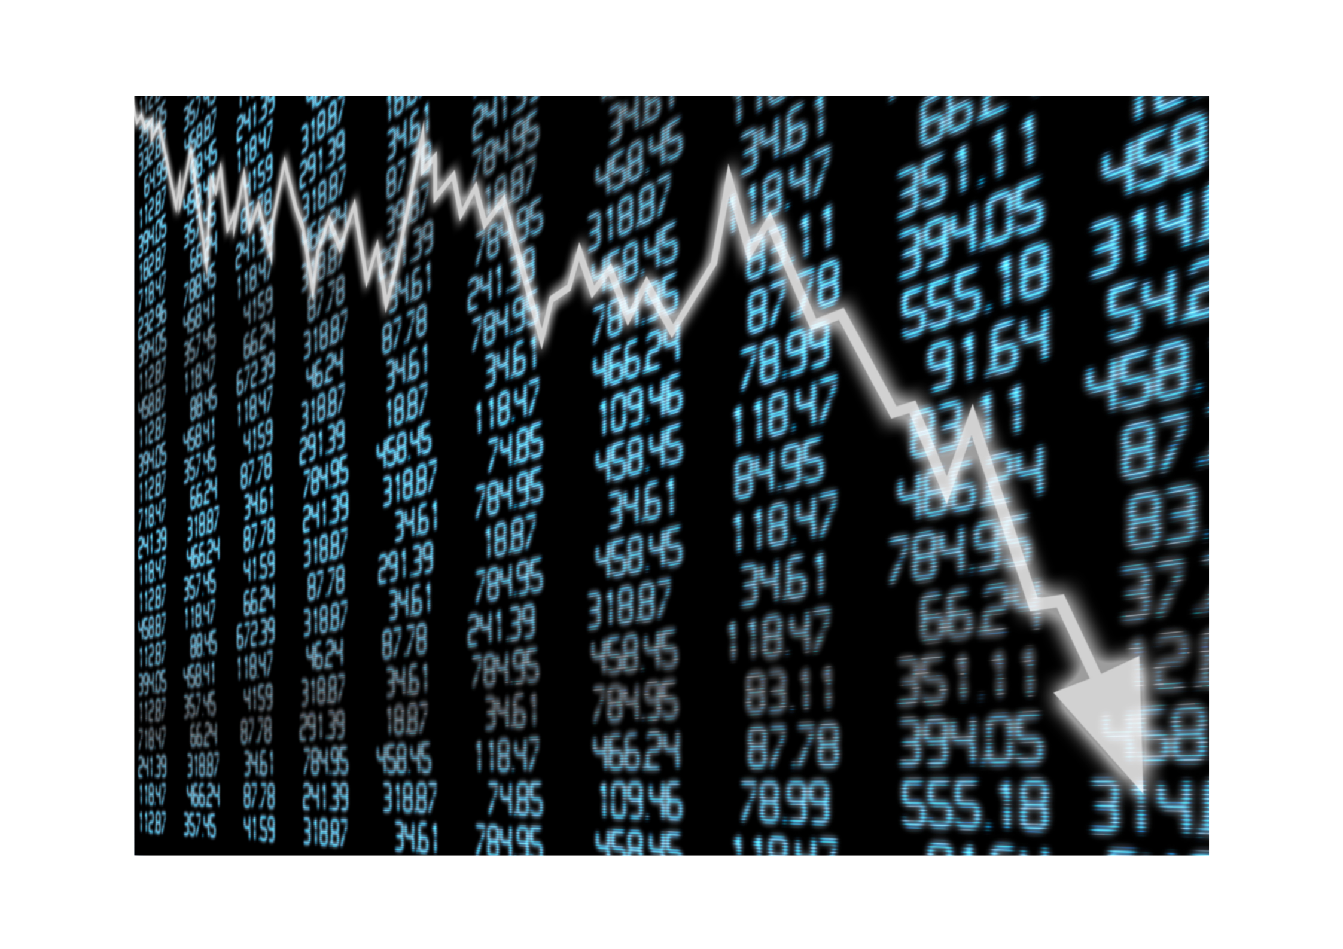
Predicting Price
The Covid19 7 day moving average together with the NASDAQ 7 Day moving average were the strongest predictors for price

Slide 7
Overall Observation
US Daily Covid19 case numbers are not strong predictors of the NASDAQ daily close price.

Slide 8
Potential Future Work
Analysis of faster moving averages of the NASDAQ price (for example by minute / hour(s)). This would however require a far larger data set to process.
Analysis of alternative data representing significant news announcements related to Covid19 (for example vaccine announcements on twitter and other news sources)

Slide 9
Thank You!
Presented by: Susanna Mir
03rd January 2021

